Slide 1
Instructions
Use this webinar to teach your audience about the importance of lead magnets and how Beacon can help. There’s a script included but feel free to make it your own.
Important
Be sure to create a promotional page for Beacon on your own website. This means that you can send your audience to your website where they will be able to click your affiliate link to access Beacon.

Slide 2
How To Make Sure Your Website Is Contributing To Your Business
(without spending a fortune)
Notes:
Hello everyone, thanks so much for joining me today. If you’re tuning in to this webinar then I can assume that your website isn’t performing as well as you would like it to. Well, the good news is that you’ve come to the right place because over the next hour I’m going to show you how to turn your website from a passive business expense into an active business asset.

Slide 3
Let’s Play A Game
Notes:
Let’s pretend that you have an employee who’s job it is to grow your business.
You spent thousands of dollars and countless hours training this person.
After a few months you realise that this employee just isn’t performing well. Sure, he shows up every day but his sales numbers are non existent.
What happens next? Do you:

Slide 4
just let it slide - maybe the employee just needs more time
sack the employee immediately - you can always hire someone else
work with the employee to help improve - after all, you’ve already invested a lot of time and money into them
Notes:
a) just let it slide - maybe the employee just needs more time
b) sack the employee immediately - you can always hire someone else
c) work with the employee to help improve - after all, you’ve already invested a lot of time and money into them
have a little think about it…

Slide 5
Employee
Website
Notes:
Before you pick your answer, try swapping the word “employee” for “website”. Would your opinion change?

Slide 6
Option A
“I spent months making that website - I’m sure it’ll work out eventually”
(it doesn’t)
Notes:
You see, I can almost guarantee that when a business’s website is underperforming most people just go with option (a) - “I spent months making that website - I’m sure it’ll work out eventually” they tell themselves (it doesn’t).

Slide 7
Option B
“Let’s build a new website - I’m sure I can get it right next time”
(you won’t)
Notes:
Or the creative amongst us will go with option (b) - “let’s build a new website - I’m sure I can get it right next time” (you won’t).

Slide 8
Option C
“We need to learn why the website isn’t meeting expectations”
(once you know the core problem you can fix it)
Notes:
The correct answer is (c) - in order to get the most from our websites (or employees!) we just need to give them a guiding hand - give them the opportunity to perform to the best of their ability.

Slide 9
Notes:
My point is this - you wouldn’t sit by and watch an employee underperform so why is it ok for your website?
Your website’s primary job is to act as 24/7 sales rep for your business but the truth is most of us don’t hold our website accountable for success.
If your site isn’t actively contributing to the growth of your business then it’s underperforming. Don’t just ignore it and don’t go back to the drawing board.
Over the next hour or so I will teach you how to whip your website into shape so it can become the money generating asset it was supposed to be.
I’m going to start by showing you an example of a web page that is working hard for the business.

Slide 10
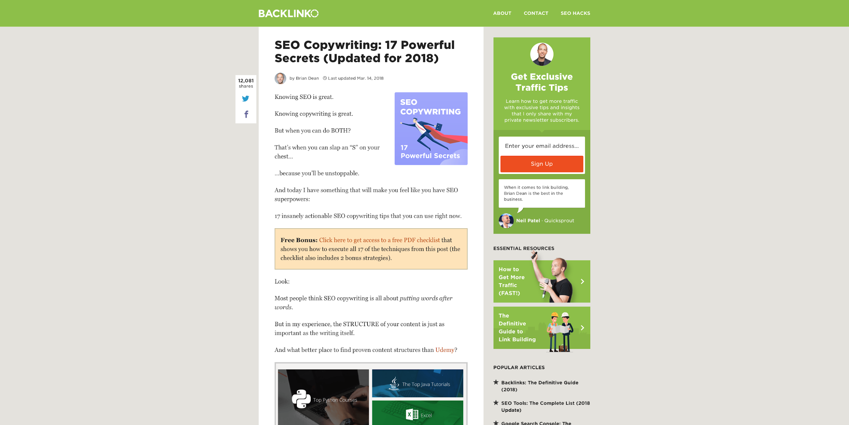
Notes:
This is a blog post on a website called “Backlinko”. The website is run by a guy called Brian Dean and he teaches people how to get more search engine traffic to their website.
So this screenshot is of a single blog post on his website and at first glance you can see that it looks like any other blog post. There’s a headline at the top, the main article below that and some extra information at the side.

Slide 11
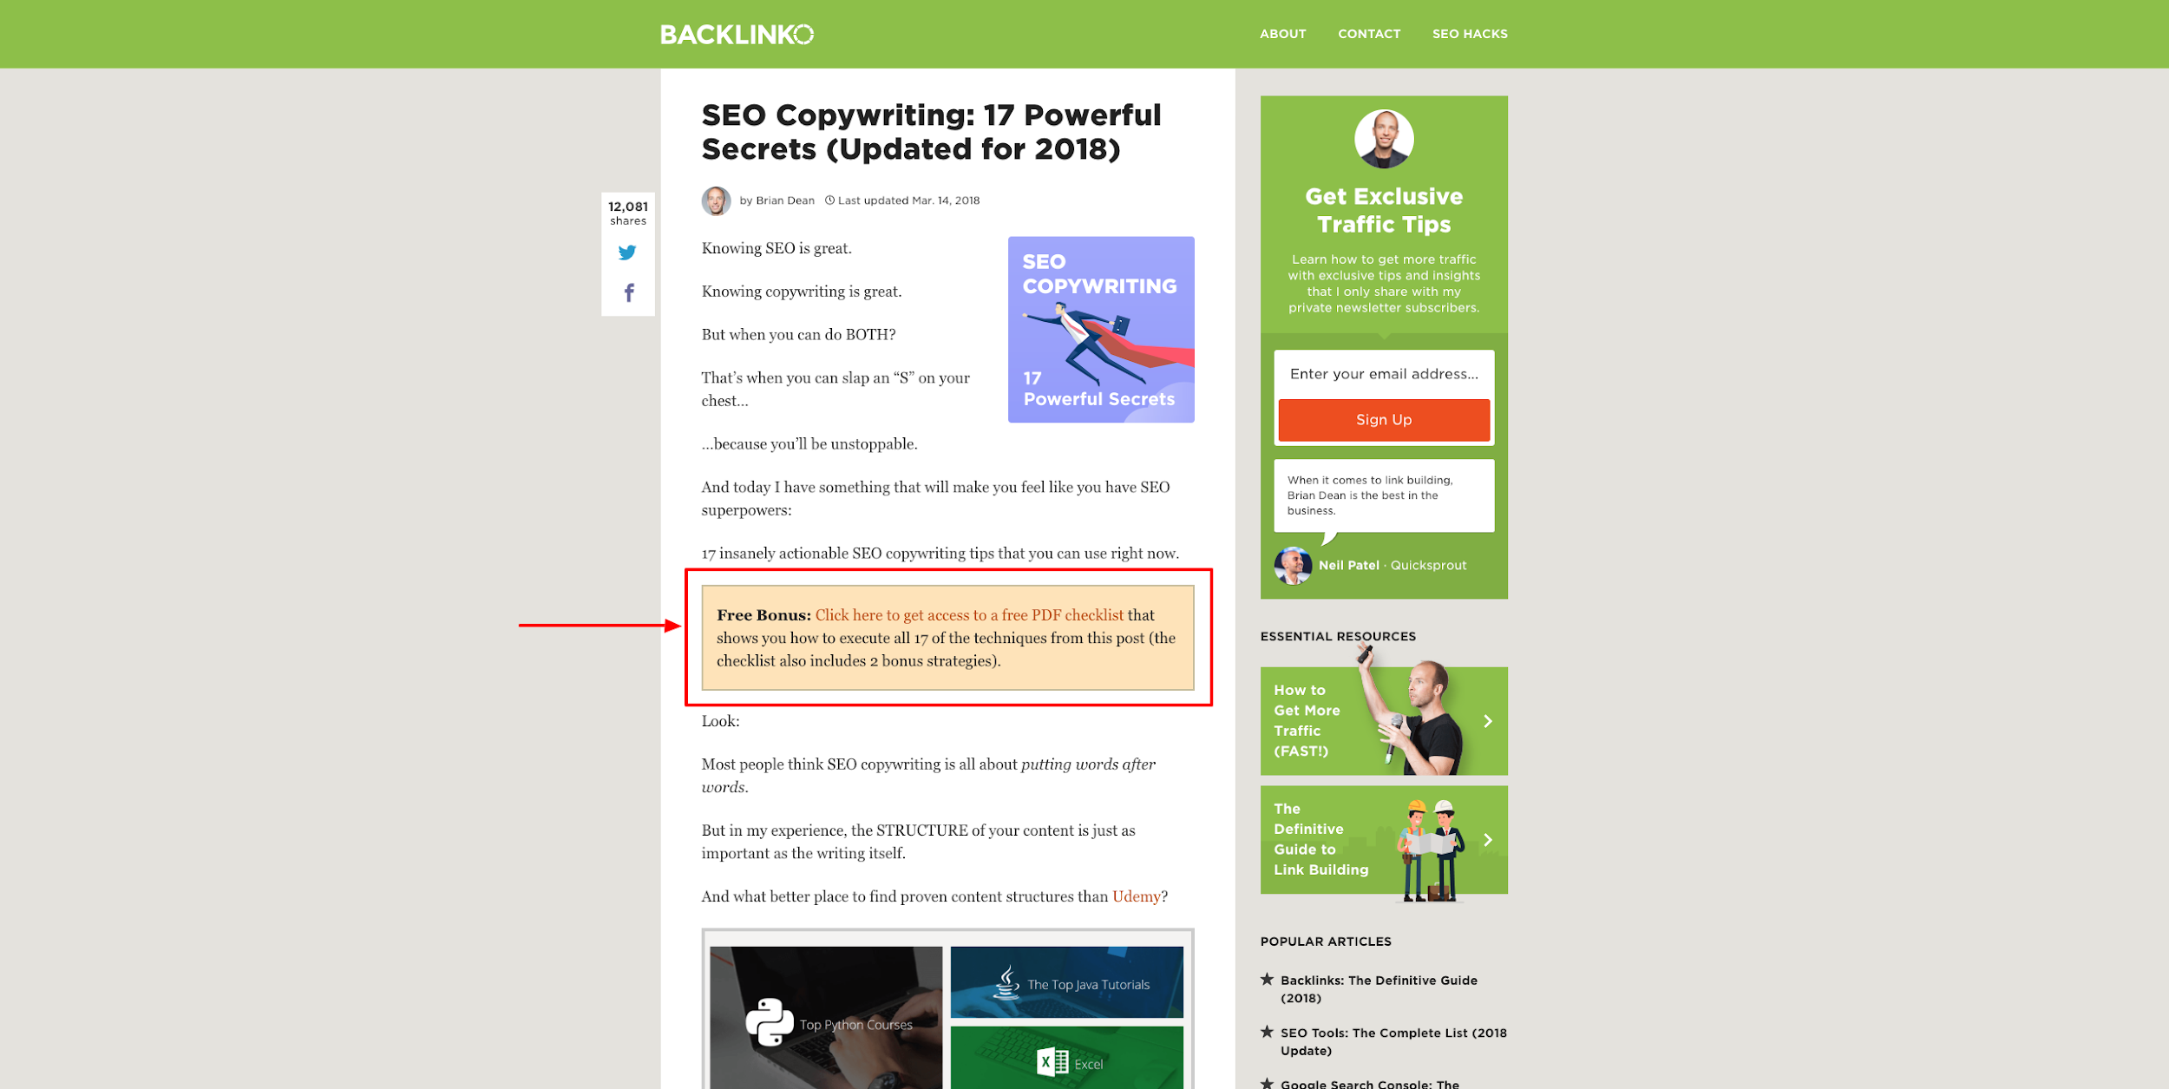
Notes:
But if you look closely you’ll see that there is a yellow box just after the post intro. And this yellow box is where the magic happens.
The text in this box reads “Free bonus, click here to get access to a free PDF checklist that shows you how to execute all 17 of the techniques from this post. The checklist also includes 2 bonus strategies”
So Brian is essentially offering a free bonus that compliments the blog post.

Slide 12
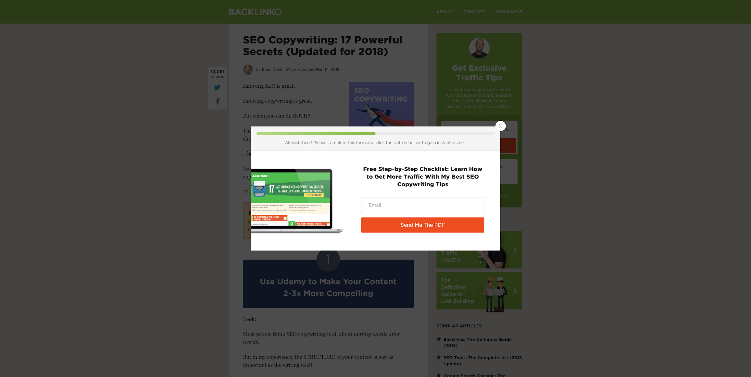
Notes:
So when someone clicks that yellow box they get this popup.

Slide 13
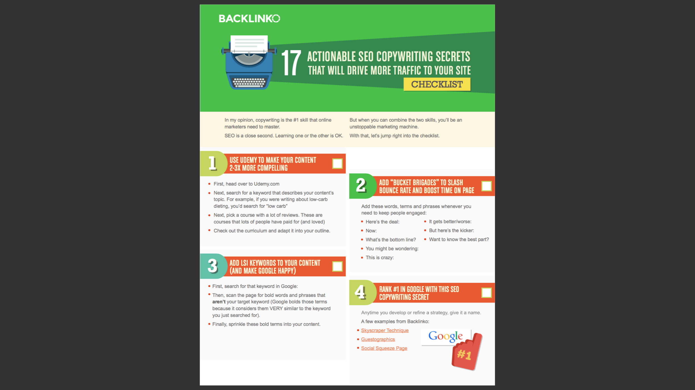
Notes:
And when they enter their email address they get sent a copy of this beautifully designed PDF.
Now there’s quite a lot of things going on there and we’ll break each step down in a minute but first I want to tell you about the results of this technique.

Slide 14
8x More Leads
Notes:
When Brian added this yellow box to that blog post he generated 8x more leads. He didn’t redesign his whole website, he didn’t just continue doing nothing. He added that simple yellow box and he increased his leads 8 times!
Just think about that - if yesterday the blog post generated 10 leads, today its generating 80 leads. That’s 70 more people who have the potential to become customers. That’s with just one small change! What would that sort of increase do for your business?!
Let’s break down each stage of this to see what’s going on so you can recreate this success for your own website.

Slide 15
Step 1
Call To Action
Offer the reader *something* of value
Notes:
The yellow box is a call to action and its purpose is to offer the reader something of value. The goal here is to take your audience from passive reading mode into taking action mode. Offer them something so good that they can’t resist clicking.

Slide 16
Step 2
Opt-In Form
Make it easy for them to do that *something*
Notes:
So if your call to action does it’s job and the reader clicks the link, they’ll be invited to enter their email address. Now, this is vitally important - if you have someone’s email address it means that you can stay in touch with them even after they have left your website. Remember that and we’ll talk more about it later.

Slide 17
Step 3
Lead Magnet
Deliver on your promise
Notes:
Finally you have to deliver on what you promised them back in the call to action. In this case Brian gives a beautifully designed PDF with some secret tips.
This PDF is known as a ‘lead magnet’ - this is the incentive that you offer someone in exchange for their email address. The lead magnet is the centre of the strategy but it’s also the most difficult part to get right…

Slide 18
Lead Magnets
Give something of value in exchange for email address
Notes:
I don’t want you to focus too much on jargon like “lead magnets” - whenever I say the phrase ‘lead magnets’ I just want you to think that we’re offering people something of value in exchange for their email address.

Slide 19
Lead Magnets
Give something of value in exchange for email address
Notes:
But how do we define “something of value” though? That’s a pretty broad term. Brian gave away a PDF - will any PDF do?

Slide 20
Lead Magnets
Give something of value in exchange for email address
Solve a problem!
Notes:
In my opinion, the best way to give people something of value (without spending money) is to help them with a problem that they are currently experiencing.
If someone is having difficulty with something and all they have to do is hand over their email address to get a solution to that problem, most people will do that without thinking twice.

Slide 21
Lead Magnet Examples
Notes:
So let’s take a look at few concrete examples so you can see exactly what I mean by “solve a problem”

Slide 22
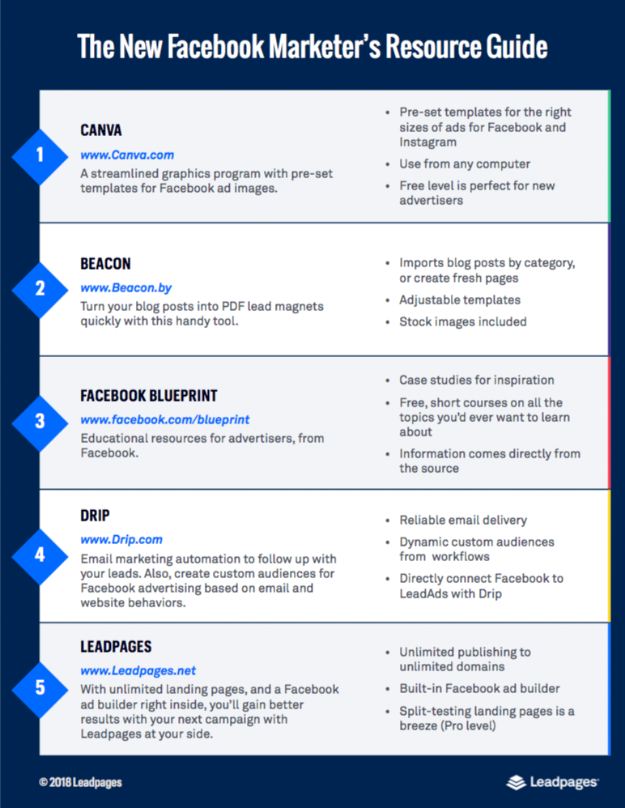
Resource Guide
Collection of ‘things’ that people can bu to improve their situation.
Problem Solved
“Our Facebook marketing strategy is not performing well.”
Notes:
The first example is a “resource guide” a resource guide is just a collection of things that people can buy to improve their situation.
The screenshot on the right hand side is the resource guide and its basically just a list of tools that people can buy along with a short description about that tool.
This particular lead magnet is titled “The new facebook marketer’s resource guide”
So the problem that the reader might be experiencing is “our facebook marketing strategy is not performing well”
This lead magnet helps with that.
People love to buy tools that solve a problem because it’s a bit of a shortcut - that’s why resource guides are so popular. If I can buy something that solves a problem and saves me a bit of time then you can be sure I’m going to do that.

Slide 23
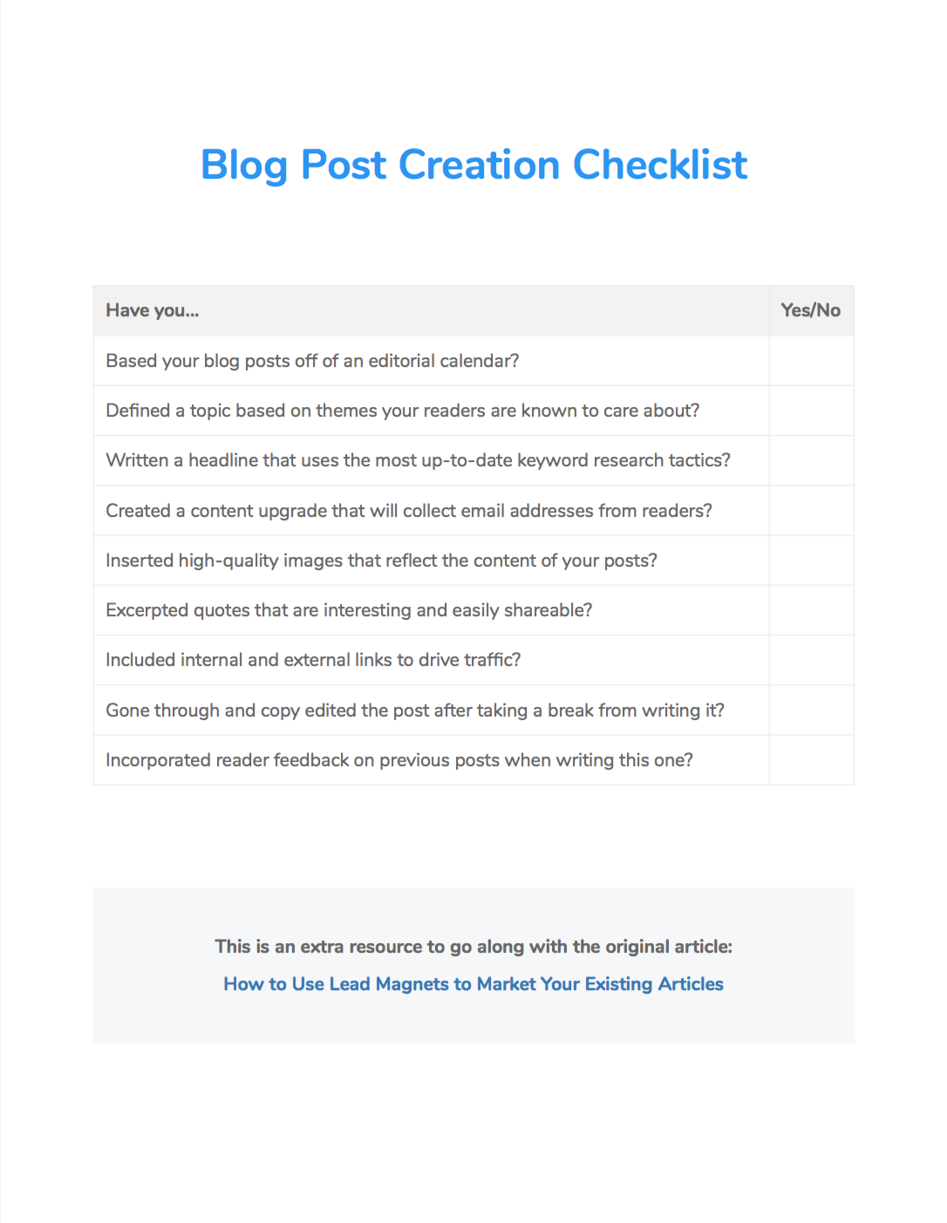
Checklist
A series of actionable tasks that people can complete to achieve a goal.
Problem Solved
“I’m new to blogging and I have no idea what I should be doing.”
Notes:
Next we have the checklist.
A checklist is basically a series of actionable tasks that people can complete to achieve a goal.
So this example is a ‘blog post creation checklist’ and this solves a problem for people who are new to blogging and have no idea what they should be doing.
This checklist basically leads them through that process and they can tick of items as they complete them.
Again, it’s a really easy checklist to create but because it has that interactive element, that physical task of checking items off, people feel like you’re really helping them.

Slide 24
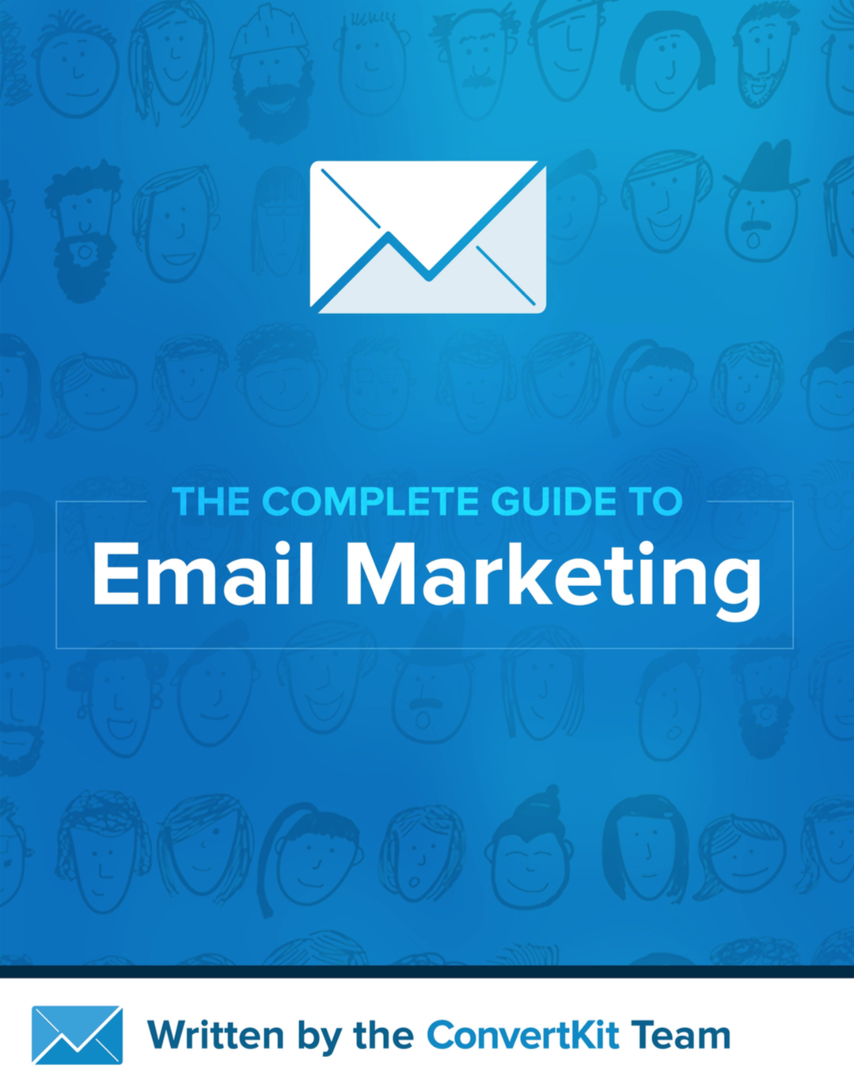
eBook
A detailed guide about a particular subject.
Problem Solved
“Email marketing seems like a complex topic. Where do I even begin?”
Notes:
The eBook is a lead magnet that takes a bit more time to create but for the reader it’s totally worth it.
This example is “the complete guide to email marketing” and it’s perfect for people who might be a little be scared of email marketing because it’s such a big topic.
The team at Convertkit put this eBook together so that people could get all the information they need in one place. They don’t have to read 50 different articles on 50 different websites. Instead, they download one PDF, they can keep it and refer back to it whenever they need to. Problem solved!

Slide 25
Lookbook
A collection of visual assets (images or videos) that are all based around the same topic.
Problem Solved
“I have a tight deadline but am all out of inspiration.”
Notes:
This last example is a ‘lookbook’
Which is basically just a collection of visual assets that are all based around the same topic.
In this example, the creator has compiled 37 screenshots of beautifully designed Christmas emails.
This type of lead magnet is perfect for designers who might be on a tight deadline and are struggling for inspiration.
The main value this lead magnet provides is convenience. Like the eBook example, this lookbook saves the reader from having to search the web for lots of different images - it’s valuable because it saves so much time and the content is curated so you can be sure that it’s of a high quality. That’s why people won’t think twice about sharing their email address to get it.

Slide 26
What Makes A Good Lead Magnet?
Valuable
Solves an immediate problem
Well designed
Builds the author’s credibility
Leads on to future interactions
Notes:
So that was just 4 examples of different lead magnets but you’ll probably have noticed that they all have certain things in common.
And these commonalities are what separates a good lead magnet from a bad lead magnet.
You’ll notice that each of these examples:
- Are valuable - they solved actual problems that a reader was experiencing
not only that but they solved a problem that the reader was experiencing at that current time - not 6 months from now.
They were all well designed, which in turn makes them feel more valuable.
The content in each of these was such high quality that it helps to build the author’s credibility
Finally all the lead magnets that we just saw had the potential to lead on to future interactions. Take the eBook for example - once someone learns about email marketing they’re going to need some software. So who do they look to for that software? The people that wrote the book on it of course!

Slide 27
How Do You Actually Make A Lead Magnet?
Notes:
So all those examples look pretty fancy, and the design of your lead magnet is very important. It’s important that the lead magnet FEELS valuable - that’s a big part of the reason people opt-in.
So how do you actually go about making your lead magnet? Well, you have a few options…

Slide 28
Option 1
DIY
(be careful)
Notes:
You can design it yourself. But unless you have some experience you could do more harm to your brand than good.

Slide 29
Option 2
Hire A Designer
(time & money)
Notes:
You could hire a designer. But that’s expensive and it does require a lot of back and forth so it’s a drain on your time.

Slide 30
Option 3
(best of both worlds)
Notes:
The third option is a tool called Beacon and it’s like a mix between option 1 and option 2.
It’s a tool that was specifically made for creating lead magnets so it has everything you need. So since you’re probably already aware of the first two options I’m going to spend some time showing you how to create a lead magnet with Beacon.
I use Beacon myself and it’s a real life saver.

Slide 31
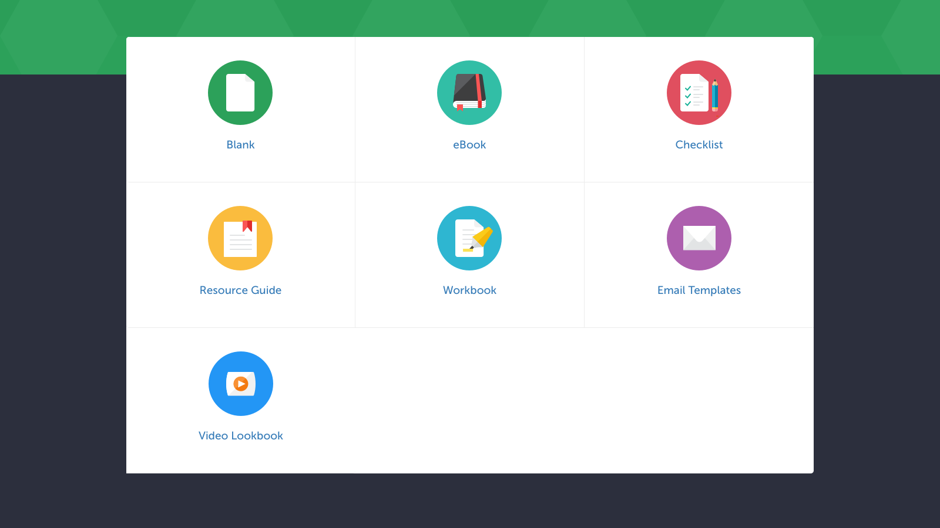
Notes:
Beacon walks you through the lead magnet creation process from start to finish. At the beginning you’ll be asked to choose your lead magnet format. You have 5 to choose from here:
eBook
Resource Guide
Checklist
Workbook
Email Templates
eBooks are probably the most popular so let’s pick that.

Slide 32
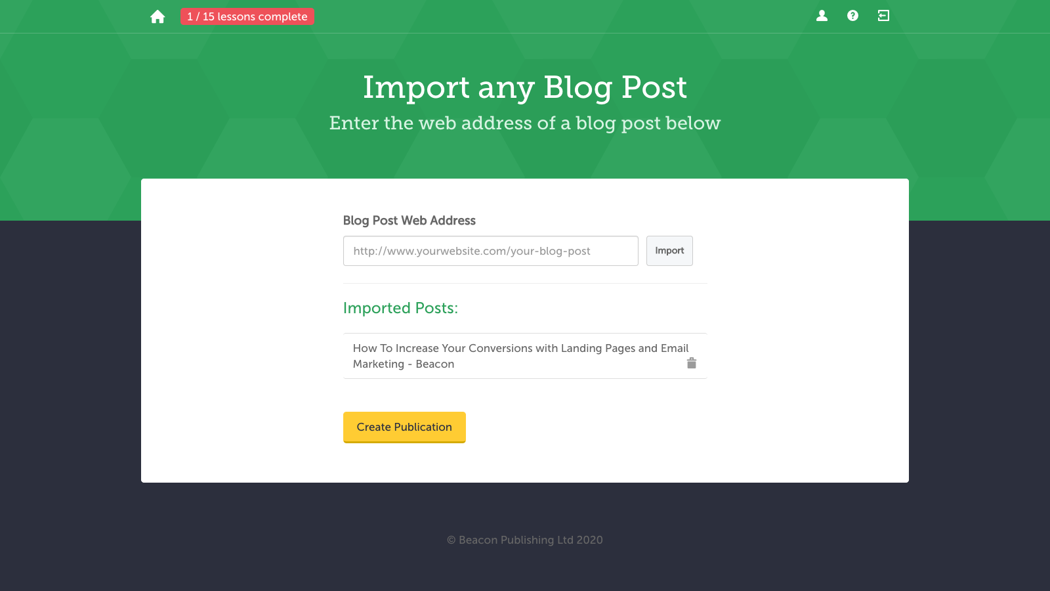
Notes:
Beacon includes lots of time saving tricks like for example, instead of writing your eBook from scratch you can recycle blog posts that you’ve already written by importing them into Beacon.
Just enter the web address and Beacon will fetch the content and add it to your eBook.

Slide 33
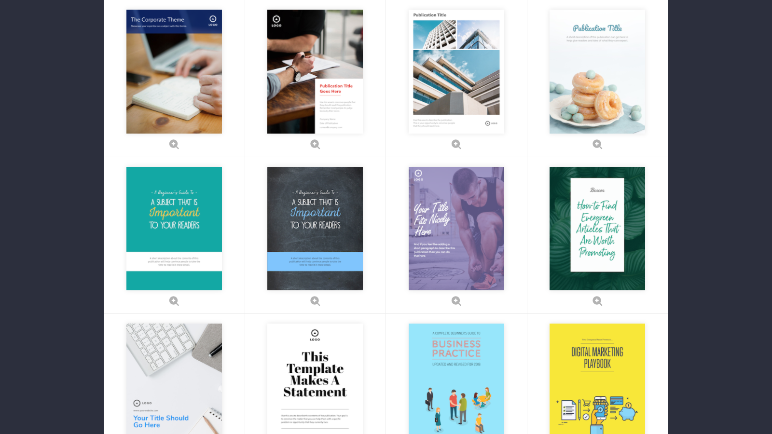
Notes:
Next you’ll want to choose a template for how your lead magnet looks. There are dozens of professionally designed templates to choose from and they are all customisable so don’t worry if you can’t find exactly what you need, just choose one that’s close to what you had in mind and then change it to suit your brand.

Slide 34
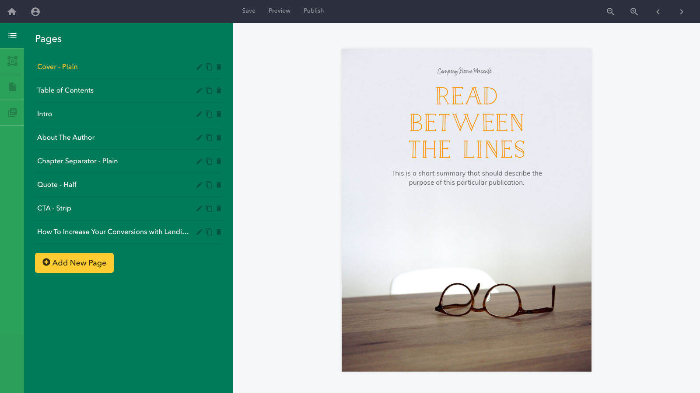
Notes:
This is the main Beacon editor and this is where you’ll be making the customisations to your lead magnet. Let’s take a quick tour.
On the right hand side here you’ll see a preview of your lead magnet.
And on the left hand side you’ll see a list of all the different pages that are included in.
Since this is an eBook it comes pre-loaded with all the pages you might expect to find - like a cover page, table of contents, about the author, and a bunch of others.
At the bottom you’ll see the content that we imported from our blog so let’s take a closer look at that.

Slide 35
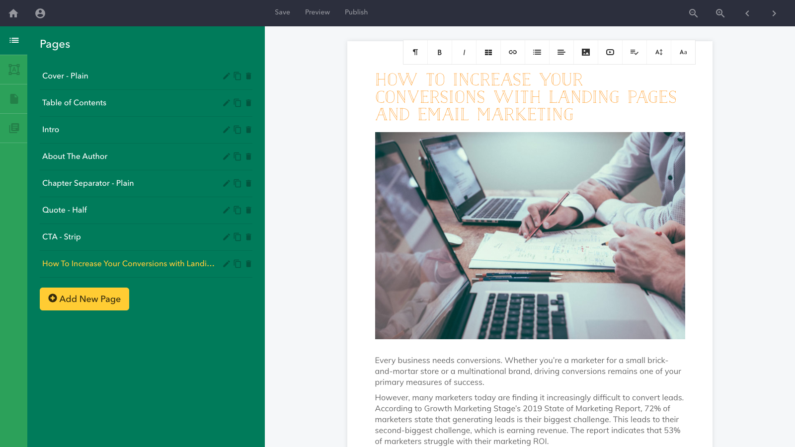
Notes:
As you can see the content that has been imported includes all images and font styling so headlines are still headlines and the lists etc are preserved. You’ll also notice that the fonts and colors won’t be the same as the ones you used in your blog. Instead they are the same fonts and colors that are used throughout the rest of the eBook. This helps to give your book a consistent look and feel even when you have imported content.

Slide 36
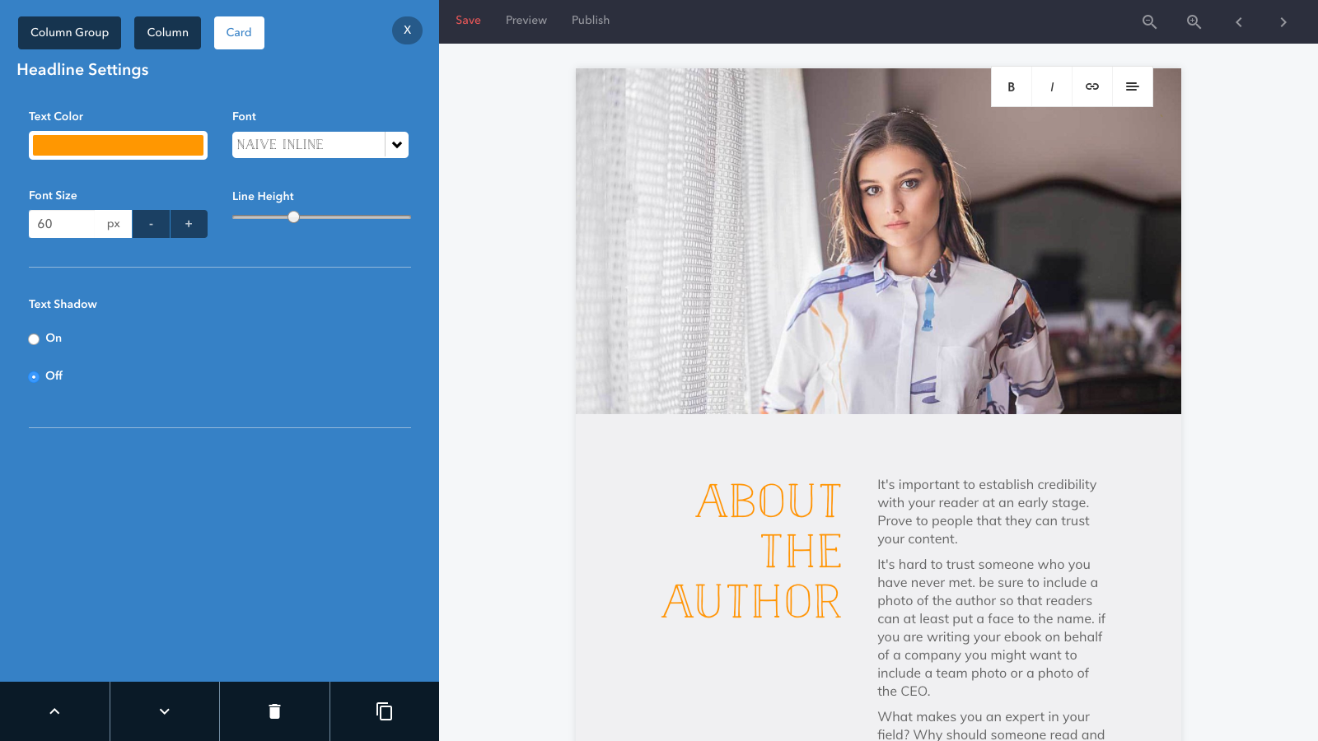
Notes:
If we look at a different page you’ll see that everything is customisable. Just click on an item and use the controls on the left-hand side to change it.
Beacon wasn’t made for designers so it’s really easy to use. You won’t find hundreds of complicated features - just the ones you need to make sure your lead magnet looks the part.

Slide 37
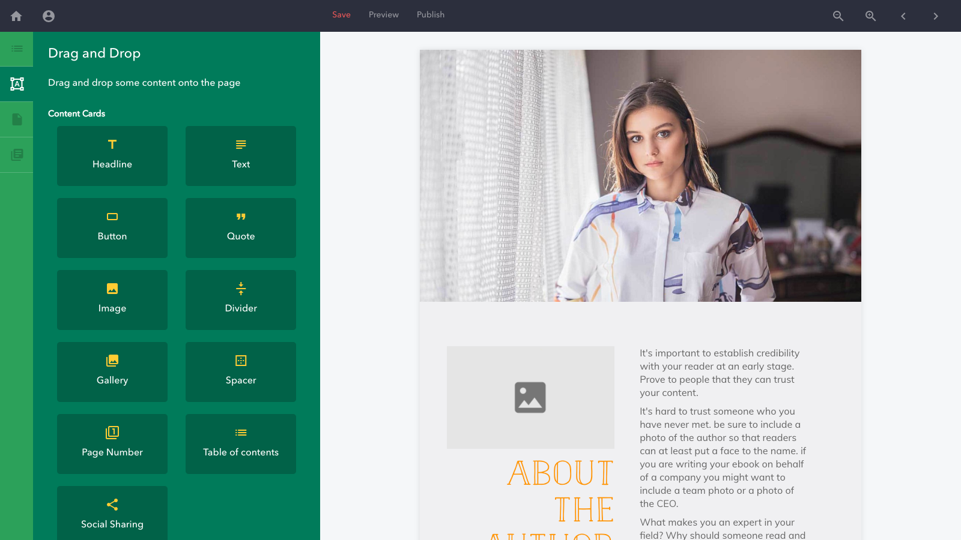
Notes:
A good example of this is the drag and drop section. Say you want to add an image to the page, just drag an image onto the page and swap the placeholder image with one of your own.
If you need to resize it you can just use these sliders.

Slide 38
Notes:
So once you’re happy with the content in your lead magnet and how it looks you’re ready to share it with the world.
One of the big problems that I hear people encounter is once they have their lead magnet they don’t really know what do with it. How do you get your lead magnet on your website so it can start collecting leads?
Well this is where Beacon has a bit of an advantage over hiring a designer or making the lead magnet yourself - because it will take care of the rest of the process for you.
So you just click the publish button at the top of the screen.

Slide 39
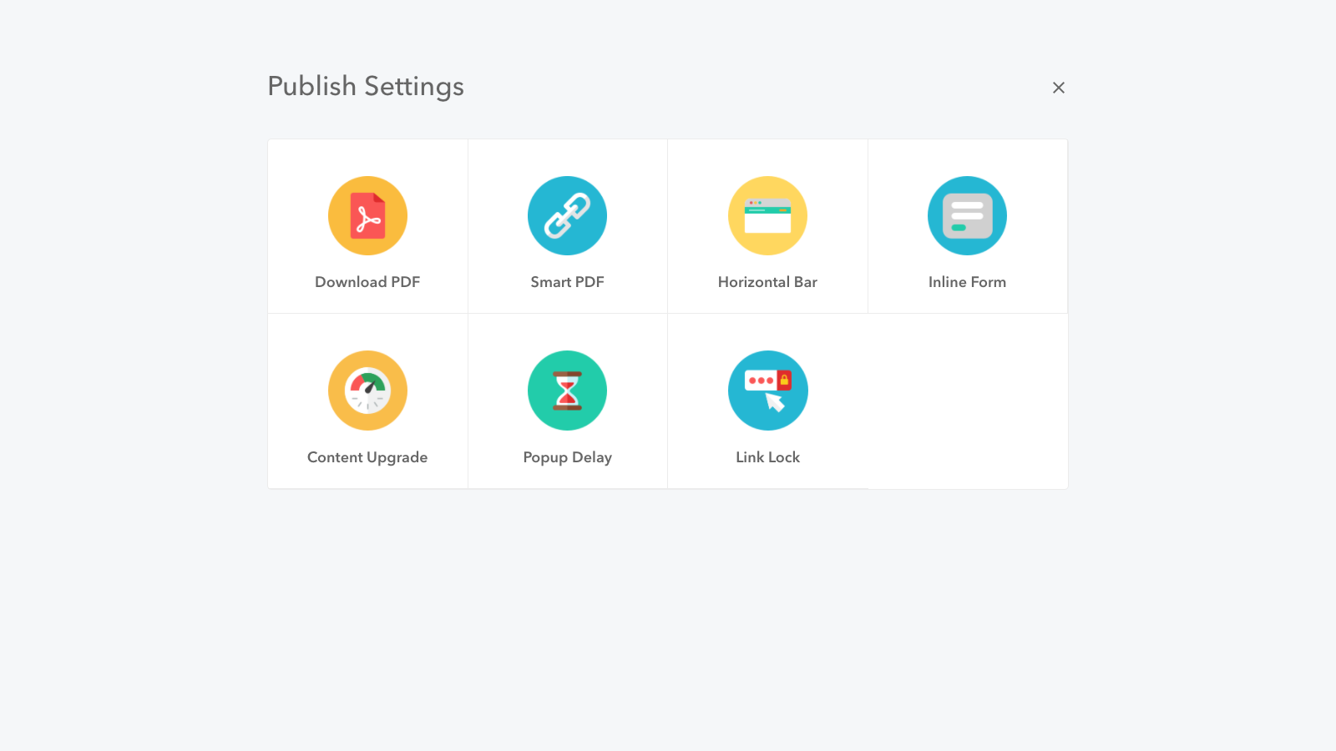
Notes:
And you have a few different options here. So you can just grab the PDF version and do whatever you want with it.
Or you can create the opt-in form and put it on your website so let’s do that.
Remember that example of Brian’s I showed you at the beginning? The one with the yellow box? Well that’s known as a content upgrade so let’s make one of those.

Slide 40
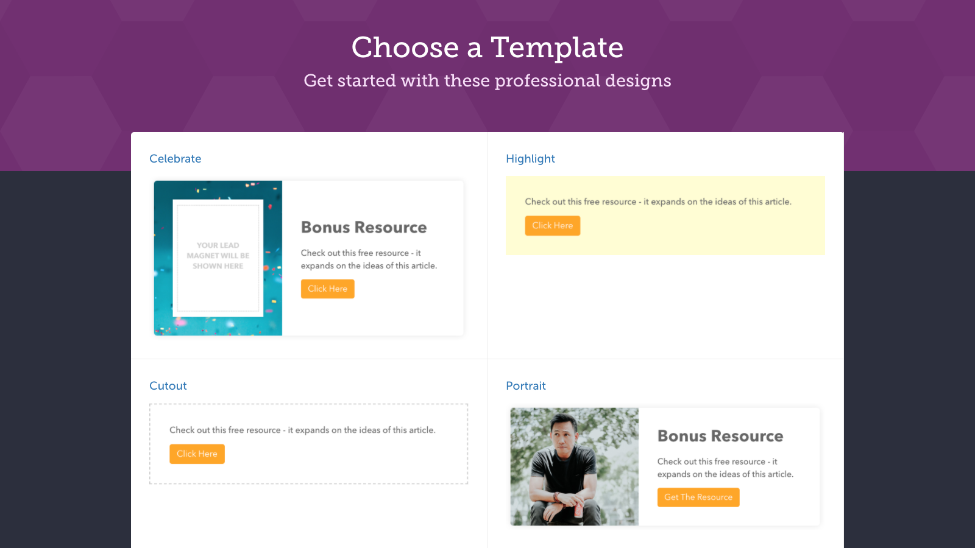
Notes:
You’ll then be taken to a new screen where you can setup your opt-in form.
These are all the different styles for our content upgrade. You can see that there are a few different options and it’s just like when we made the lead magnet - these are all customisable so don’t worry if you can’t find something that fits exactly. For our demonstration let’s go with the yellow box option just like Brian.

Slide 41
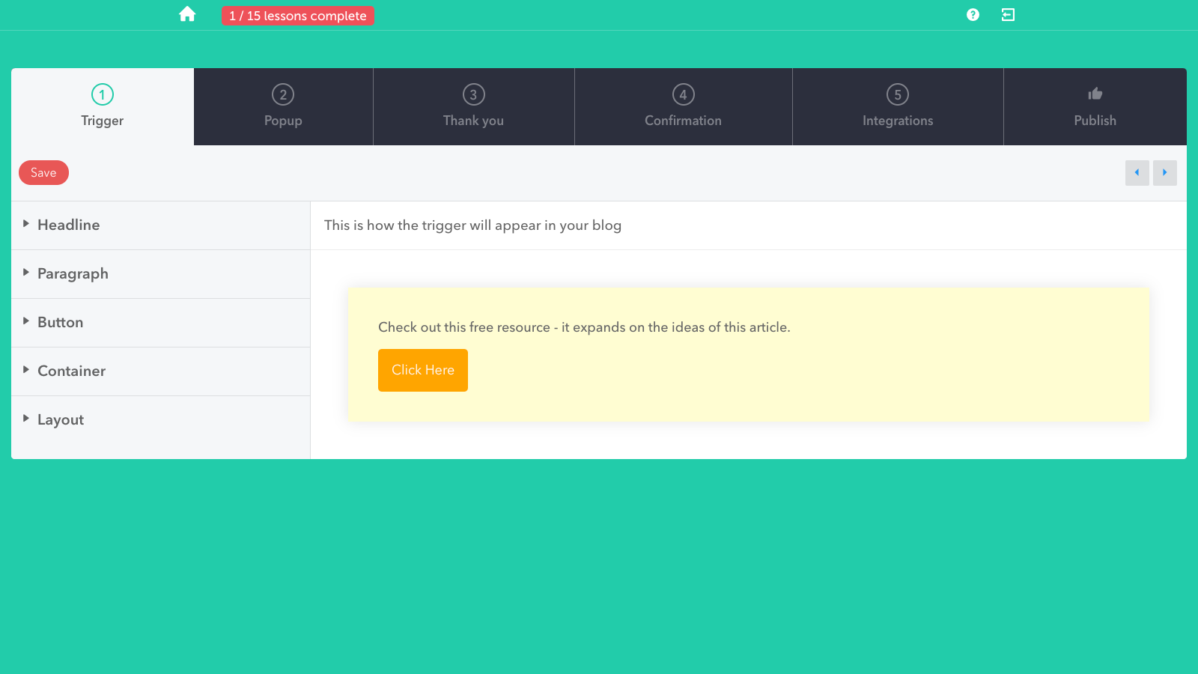
Notes:
Now we’re creating our content upgrade and if you look at the top bar you can see all the different stages that a user will go through when they opt-in for your lead magnet.
First they’ll see this trigger which is just another name for the call to action.

Slide 42
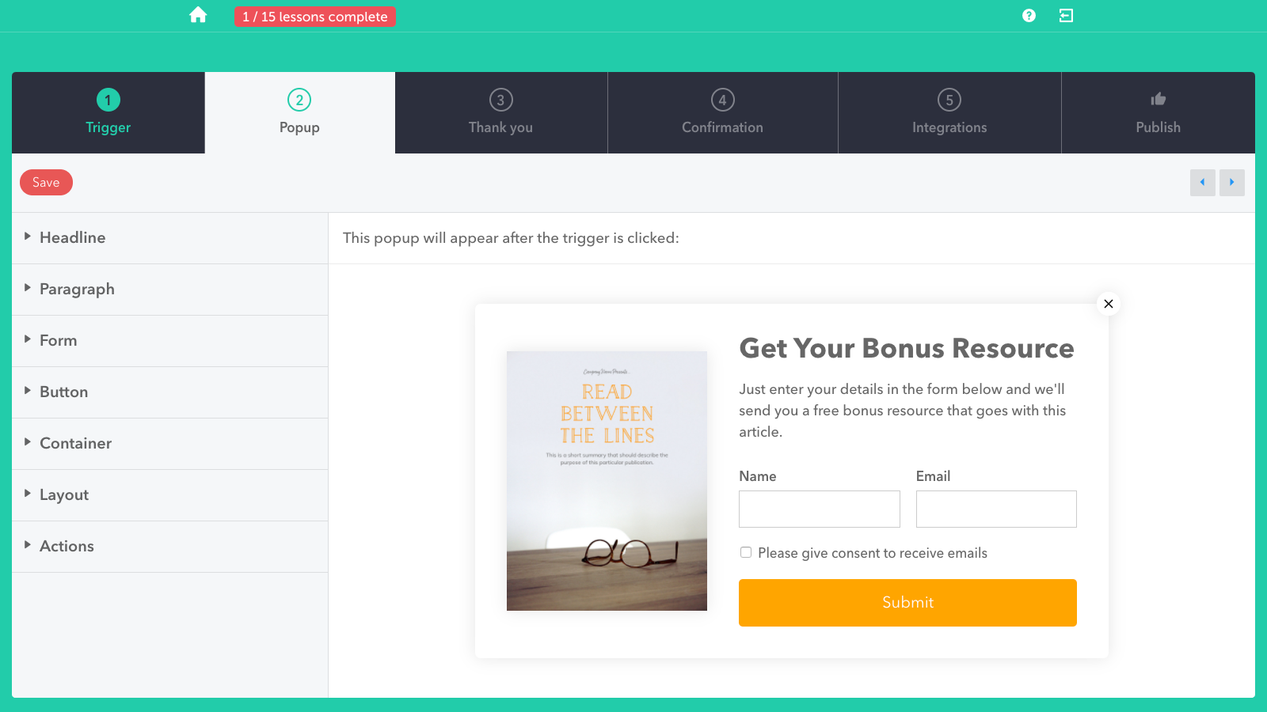
Notes:
Then when they click the trigger, they’ll see this popup.

Slide 43
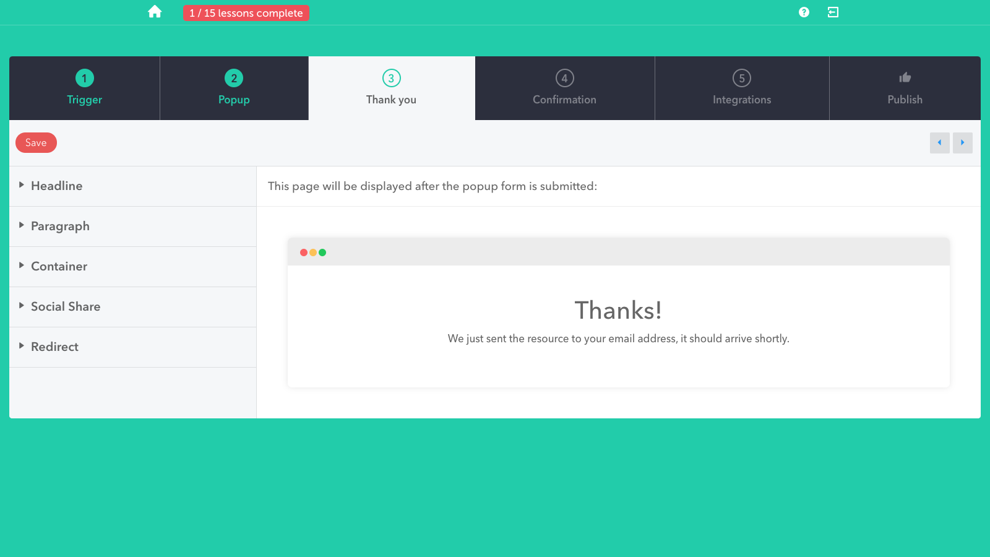
Notes:
And when they enter their details they’ll see this thank-you page

Slide 44
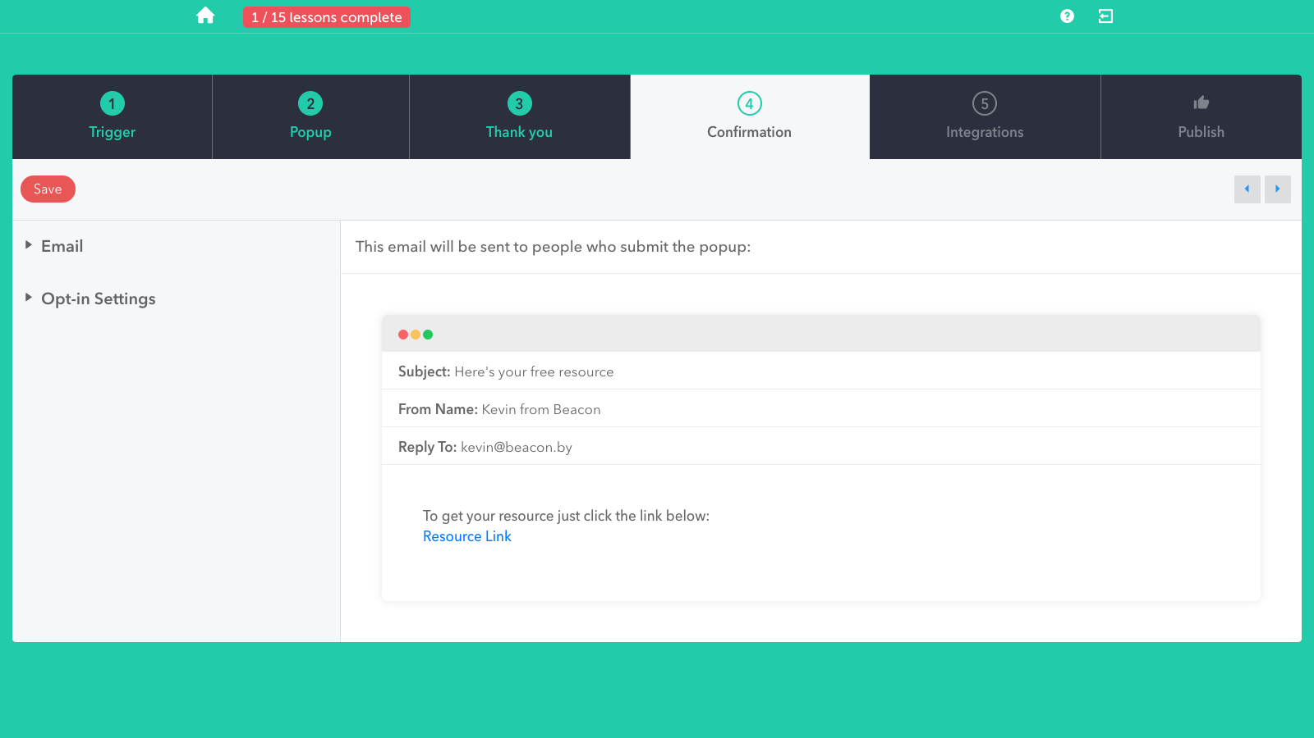
Notes:
And they’ll receive this email with a link to the lead magnet
So basically you just need to go through each of these stages and customise the text and images to suit your website.

Slide 45
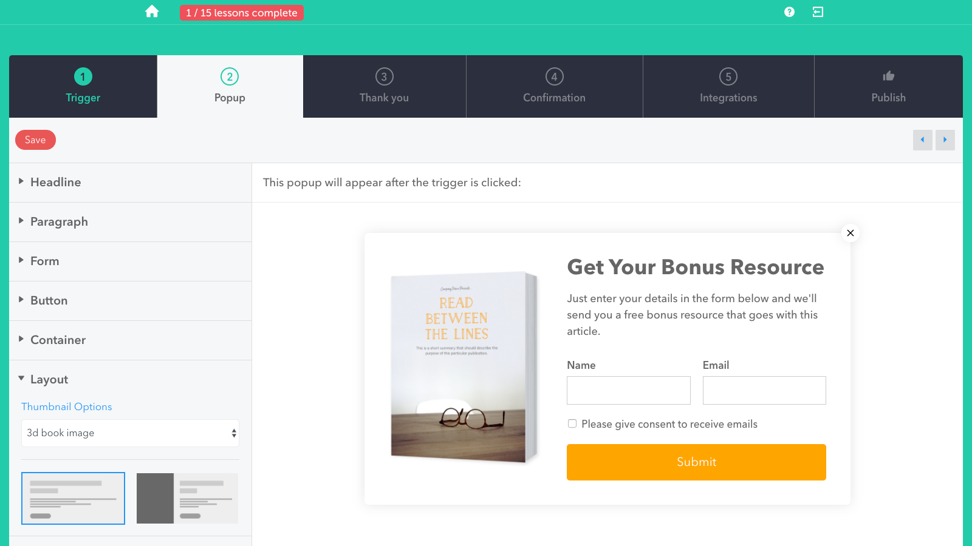
Notes:
I won’t go through each stage because it’s very straightforward and I’m conscious of time but I will show you this one trick.
If you look in the popup section there is a preview of the lead magnet. You can actually change the style of this image so you can pick between this plain image or a 3d book cover or sheets and a hardcover option.
Since Beacon handles all of this automatically you don’t have to find a designer to do this part for you.

Slide 46
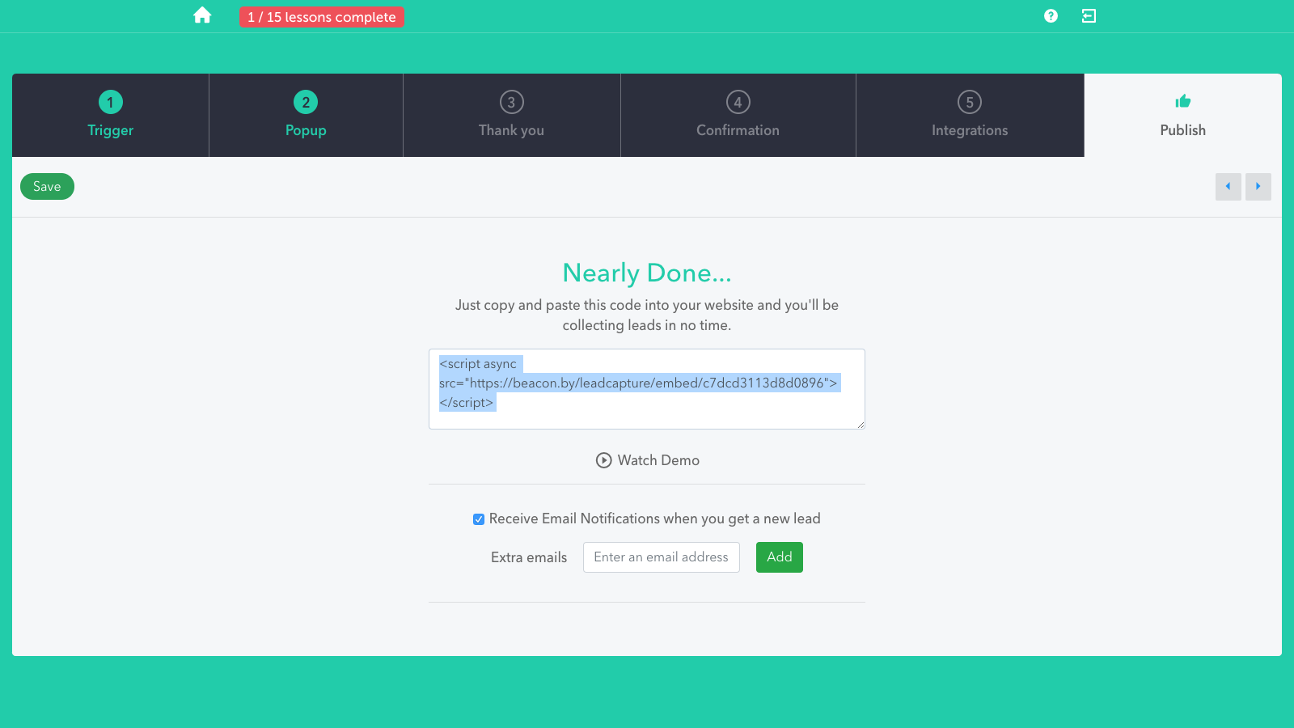
Notes:
So once you’re happy with your opt-in form you just go to the publish section and copy this few lines of code.

Slide 47
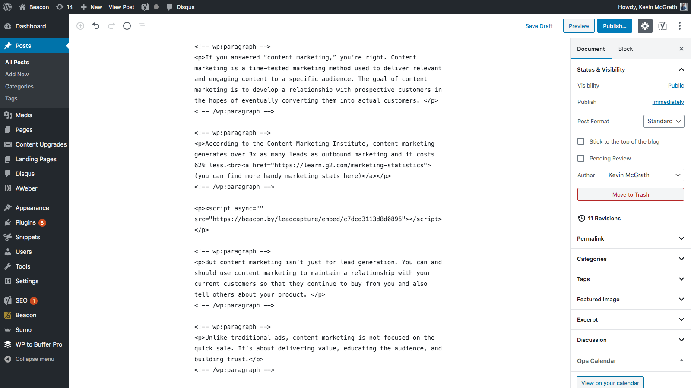
Notes:
Then if you head over to your website you can paste that in any page.

Slide 48
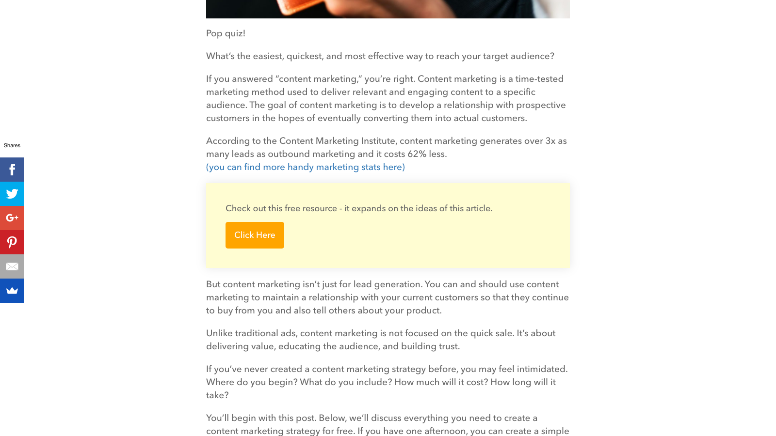
Notes:
And if you preview the page you’ll see your content upgrade!

Slide 49
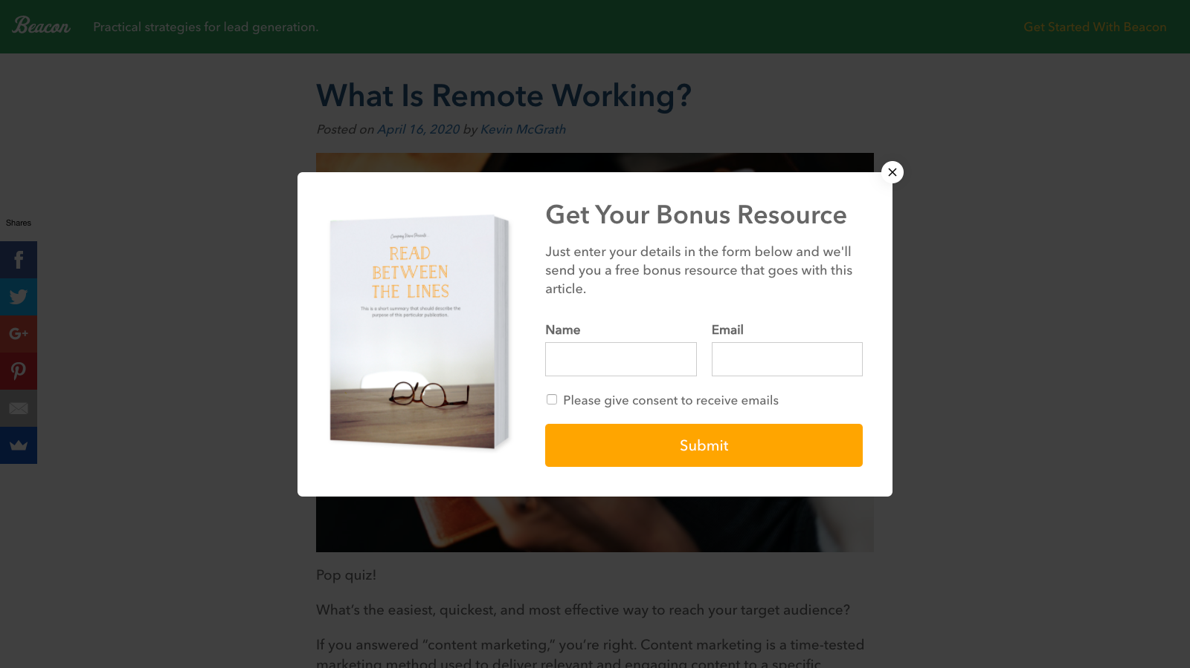
Notes:
When people click the call to action they’ll get this popup

Slide 50
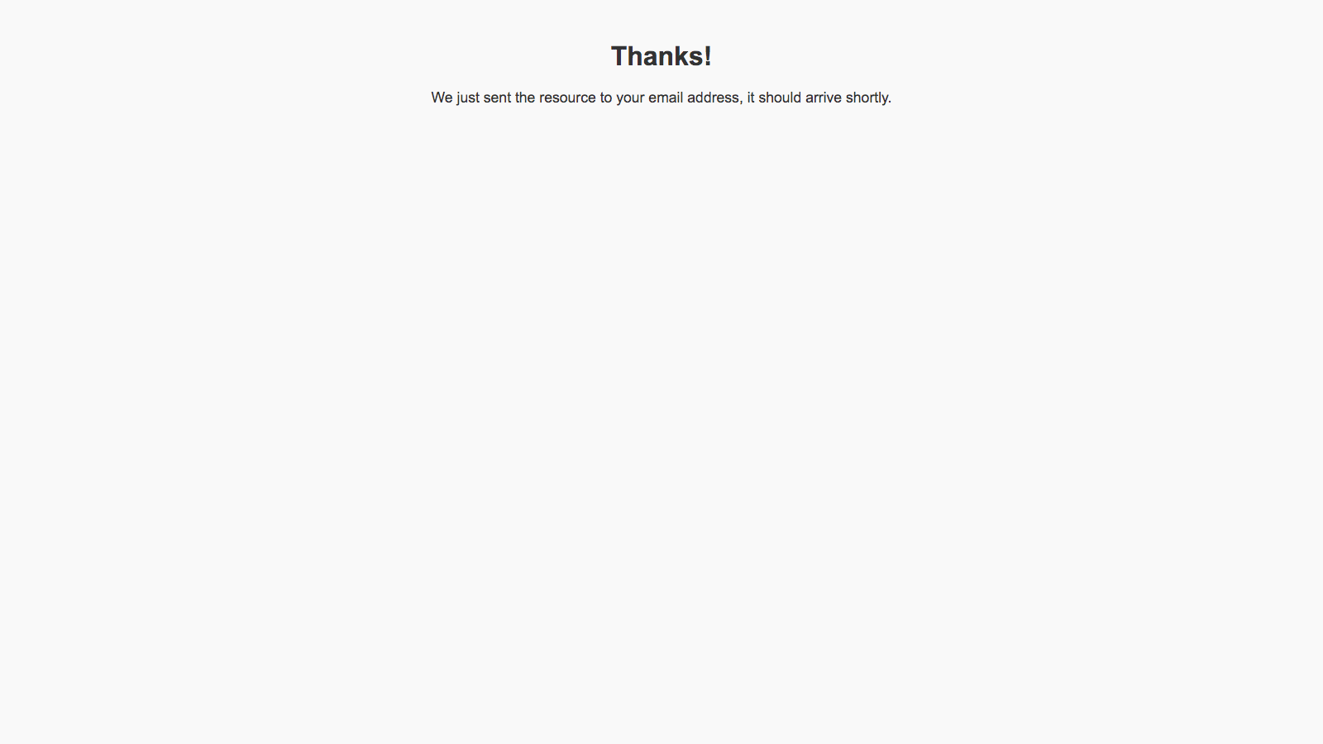
Notes:
And when they enter their details they’ll get the lead magnet instantly delivered to their inbox.

Slide 51
Recap
Solve a problem for your audience
Make a lead magnet
Offer that lead magnet on your website
Collect more email addresses
Notes:
So we started this webinar by asking how you can make your website contribute more to your business. We decided that offering our readers something of value was the way to go and in the past 10 minutes or so we’ve been able to create professional lead magnet that we can start using on our website. Once that goes live we’ll see a big increase in the number of leads that our website generates.
All of a sudden our website goes from being a passive business expense to an active asset. From lazy employee to top performing sales guy!

Slide 52
Beacon Advantages
More control for you
More cost effective
One piece of software - not three!
Notes:
And it’s Beacon that has made this change so easy. Beacon is software that is specifically designed to help you get more value from your existing website.
Because you start with professional templates and then adjust them it means you have a lot of control. It’s definitely not as expensive as hiring a designer or using something like Photoshop.
And a big reason for that is because it’s really 3 different pieces of software wrapped into one:
It helps you to design the lead magnet, to make your opt-in form and to deliver your lead magnet. By using Beacon you can actually cancel any other software services that you may have already been using to do those things.
And most importantly - Beacon works! Let’s check out some examples of people just like you who have found success with Beacon:

Slide 53
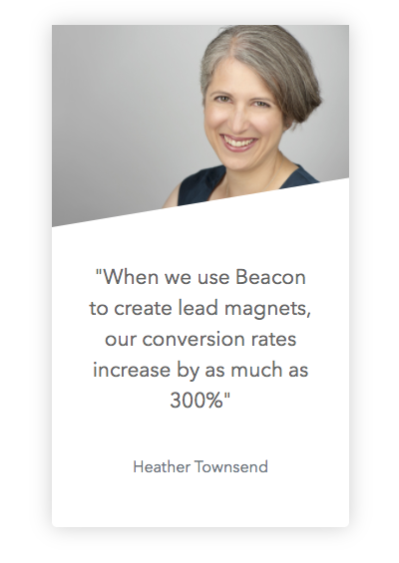
Increased Conversion Rates By 300%
Notes:
Heather had a website that was underperforming. Once she installed Beacon she was able to generate 3 times more leads than she had before. These are simple changes that can make a big difference to your business.

Slide 54
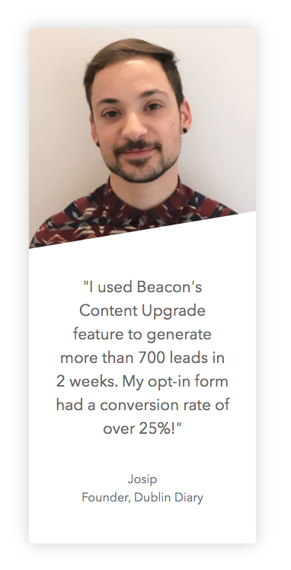
700 Leads In
Two Weeks
Notes:
Josip was already getting good traffic to his website but when he used a Beacon content upgrade he was able to convert some of that traffic into 700 actual leads.

Slide 55
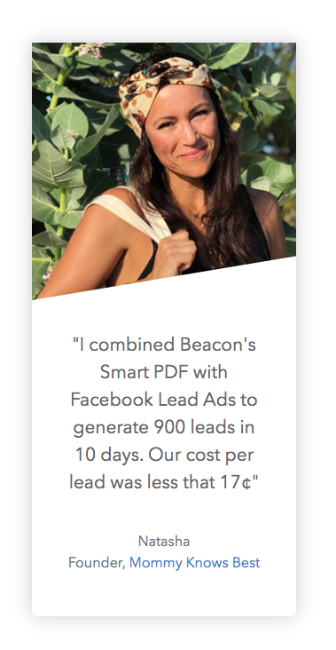
900 Leads In
Ten Days
Notes:
Natasha combined Beacon with Facebook Ads to generate 900 leads in 10 days.

Slide 56
194 High Quality Leads
Notes:
Alece used Beacon to generate hundreds of high quality leads for her short-term rental management firm in Nashville, Tennessee.

Slide 57
www.yourwebsite.com/beacon
Notes:
** PRIVATE **
Use this slide to promote your own affiliate page. Make sure you setup a page on your website that uses your affiliate link to access Beacon.
Give your audience an incentive to visit the page on your website instead of going directly to the Beacon website. This could be some bonus content or a free consultation with you. Whatever it is make sure it’s attractive enough to send people to your page!

Slide 58
But I Don’t Have Any Traffic Yet!
(that’s ok)
Notes:
Remember that driving traffic to your site BEFORE optimising for conversions is like pouring water into a leaky bucket.
Optimise your site first and you’ll be ready to make more efficient use of the traffic that you get.
Conversion rate first - traffic second!

Slide 59
I Don’t Need An Email List
(you will)
Notes:
It can take months or years to build an email list. If you start today then you can build a relationship with your audience so when you do have a product to sell they will already know and trust you.

Slide 60
www.yourwebsite.com/beacon
Notes:
** PRIVATE **
Use this slide to promote your own affiliate page. Make sure you setup a page on your website that uses your affiliate link to access Beacon.
Give your audience an incentive to visit the page on your website instead of going directly to the Beacon website. This could be some bonus content or a free consultation with you. Whatever it is make sure it’s attractive enough to send people to your page!

Slide 61
Most People Who Come To Your Website Aren’t Ready To Buy
Lesson
(yet)
Notes:
Let’s wrap up this webinar with a quick recap of the major lessons we covered today:
Firstly, most people who come to your website aren’t ready to buy.
It’s just a fact. Most people are conducting research. They *might* come back if you make a good first impression.

Slide 62
Keep In Touch With People After They Leave Your Site
Lesson
(trust me)
Notes:
Secondly, you need to keep in touch with people after they leave your site.
Don’t leave anything to change - get their email address so you can contact them instead of waiting for them to call you back.

Slide 63
Email Is Still The Number One Sales Tool
Lesson
(yep, you read that right)
Notes:
Third, believe it or not but email is still the number one sales tool for growing a business.
Social media might be all the rage but the inbox is where business happens. Prioritise email above all else. You’ll thank me later.

Slide 64
Don’t Just Collect Email Addresses
Lesson
(treat them like people and build a relationship)
Notes:
And finally, I don’t want you to just collect email addresses for the sake of it.
It’s not good building a massive list of anonymous names. Build a relationship with your subscribers. Show your personality and get to know theirs.

Slide 65
www.yourwebsite.com/beacon
Notes:
** PRIVATE **
Use this slide to promote your own affiliate page. Make sure you setup a page on your website that uses your affiliate link to access Beacon.
Give your audience an incentive to visit the page on your website instead of going directly to the Beacon website. This could be some bonus content or a free consultation with you. Whatever it is make sure it’s attractive enough to send people to your page!

